Slide 1
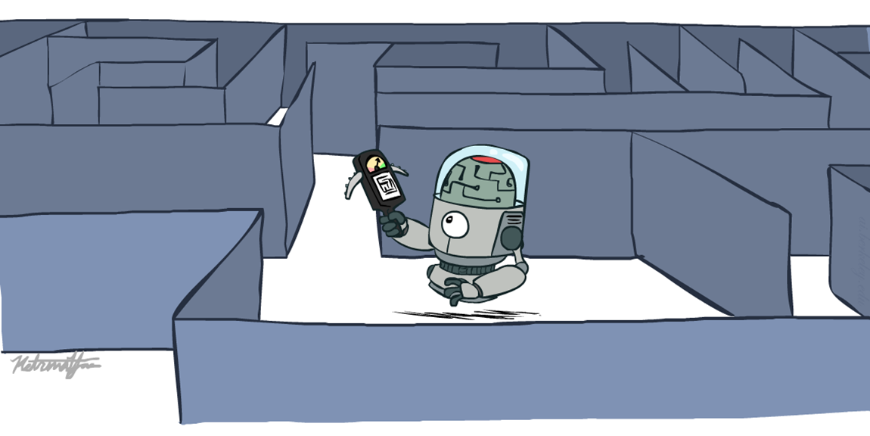
Informed Search
Heuristics Search

Slide 2
Recap: Search
Search problem:
States (configurations of the world)
Actions and costs
Successor function (world dynamics)
Start state and goal test
Search tree:
Nodes: represent plans for reaching states
Plans have costs (sum of action costs)
Search algorithm:
Systematically builds a search tree
Chooses an ordering of the fringe (unexplored nodes)
Optimal: finds least-cost plans

Slide 3

Video of Demo Maze Water DFS/BFS (part 1)

Slide 4
Video of Demo Maze Water DFS/BFS (part 2)

Slide 5
Video of Demo Contours UCS Empty

Slide 6
Video of Demo Contours UCS Pacman Small Maze

Slide 7
Today
Informed Search
Heuristics
Greedy Search
A* Search

Slide 8
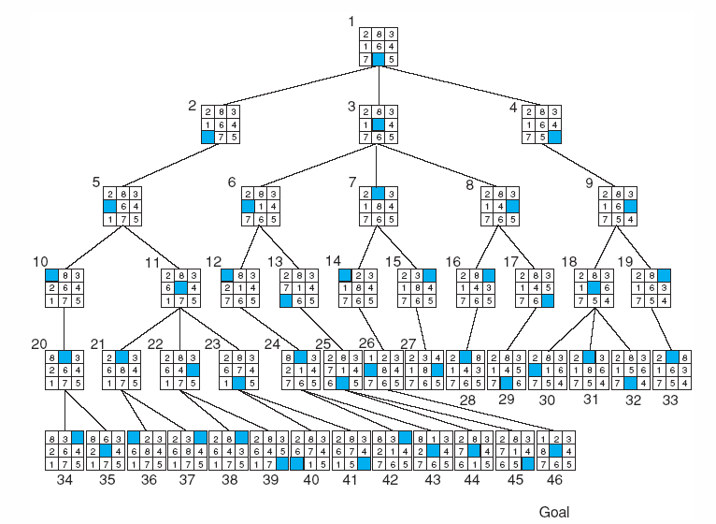
Breadth-first search of the 8-puzzle, showing order in which states were removed from open.

Slide 9
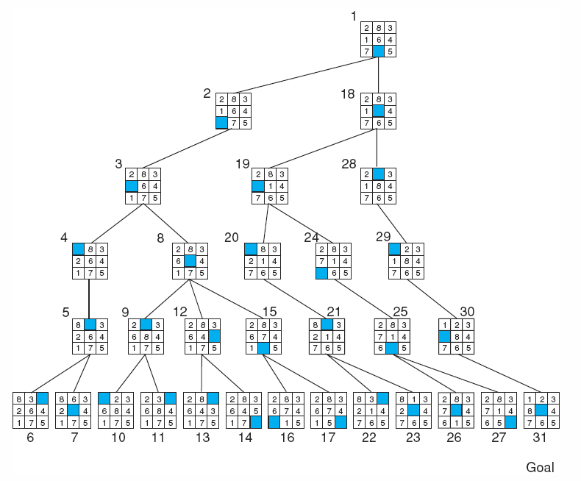
Depth-first search of the 8-puzzle with a depth bound of 5.

Slide 10
Using problem specific knowledge to aid searching
With knowledge, one can search the state space as if he was given “hints” when exploring a maze.
Heuristic information in search = Hints
Leads to dramatic speed up in efficiency.
A
B
C
D
E
Search only in this subtree!!
F
G
H
I
J
K
L
M
N
O

Slide 11
Introduction
Heuristic search is a problem-solving technique used in artificial intelligence to efficiently explore a search space and find the optimal or near-optimal solution. It involves using heuristic functions or rules of thumb to guide the search algorithm towards the most promising branches of the search space.
Heuristic search is widely used in various applications, including game playing, route planning, scheduling, and robotics, where the search space is too large to explore exhaustively.

Slide 12
What are Heuristics?
Heuristics are know-hows obtained through a lot of experiences.
Heuristics often enable us to make decisions quickly without thinking deeply about the reasons.
The more experiences we have, the better the heuristics will be.

Slide 13
When Heuristics are used?
AI problem solvers employ heuristics in two basic situations:
A problem may not have an exact solution because of inherent ambiguities in the problem statement or available data.
Medical diagnosis: Given symptoms may have several possible causes;
Doctors use heuristics to choose the most likely diagnosis and formulate a treatment plan.
A problem may have an exact solution, but the computational cost of finding it may be prohibitive.
Chess: state space growth is combinatorically explosive, with the number of possible states increasing with the depth of the search.
Heuristics attack this complexity by guiding the search along the most “promising” path through the space.

Slide 14
Heuristic function
The heuristic function is a function that estimates the distance or cost from a particular state to the goal state. It helps the search algorithm to evaluate the desirability of a particular node or path based on the estimated distance or cost to the goal state.
Heuristic search algorithms include A* search, iterative deepening A*, greedy best search, and hill climbing. These algorithms differ in the way they use the heuristic function to guide the search process.

Slide 15
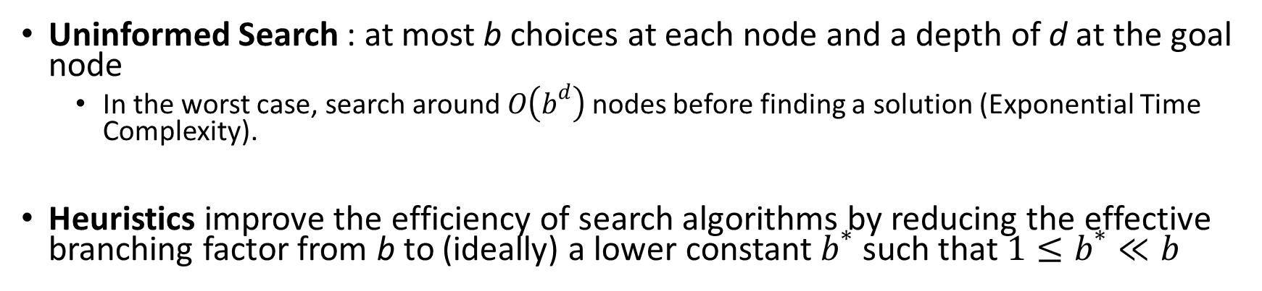
Why heuristic functions work?
Uninformed Search : at most b choices at each node and a depth of d at the goal node
In the worst case, search around $O\left(b^{d}\right)$ nodes before finding a solution (Exponential Time Complexity).
Heuristics improve the efficiency of search algorithms by reducing the effective branching factor from b to (ideally) a lower constant $b^{∗}$ such that$1≤b^{∗}≪b$
Guide search towards the goal instead of all over the place
Start
Goal
Start
Goal
Informed
Uninformed

Slide 16
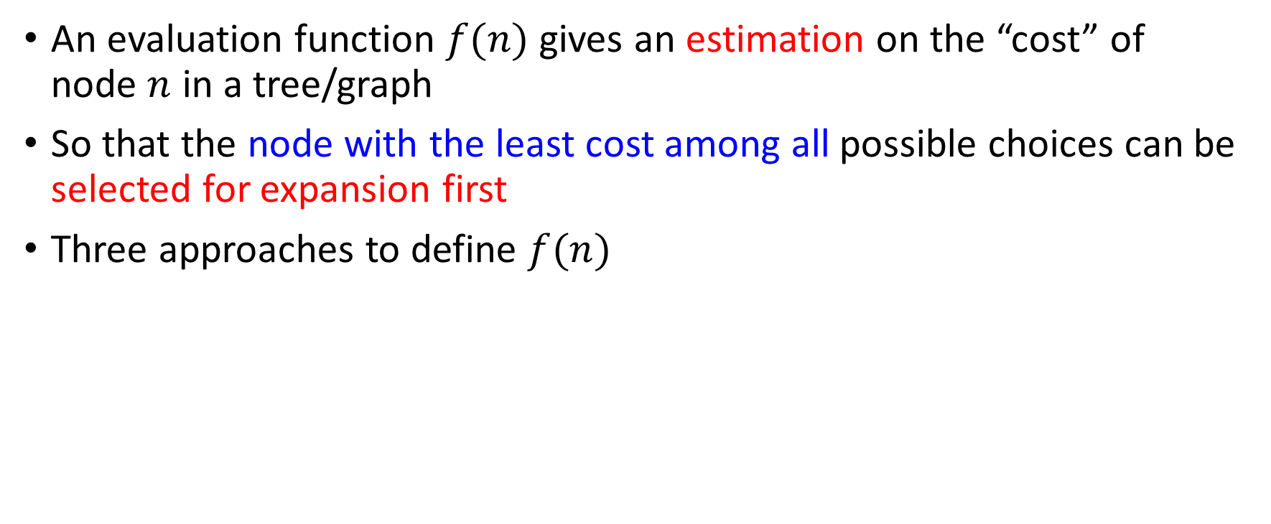
Evaluation Function
An evaluation function $f(n)$ gives an estimation on the “cost” of node $n$ in a tree/graph
So that the node with the least cost among all possible choices can be selected for expansion first
Three approaches to define $f(n)$

Slide 17
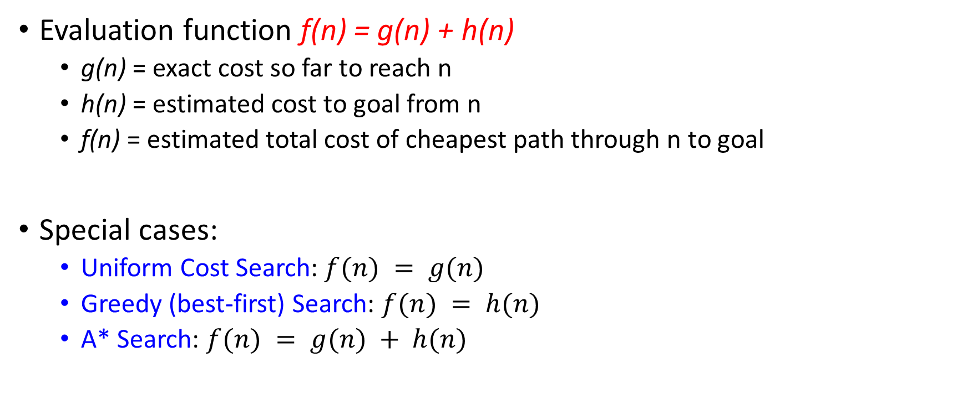
Evaluation / Heuristic Function
Evaluation function f(n) = g(n) + h(n)
g(n) = exact cost so far to reach n
h(n) = estimated cost to goal from n
f(n) = estimated total cost of cheapest path through n to goal
Special cases:
Uniform Cost Search: $f(n) = g(n)$
Greedy (best-first) Search: $f(n) = h(n)$
A* Search: $f(n) = g(n) + h(n)$

Slide 18
How it works?
Idea: use heuristic function for each node
that estimates desirability
Expands most desirable unexpanded node
Implementation:
fringe is a queue sorted in order of desirability
Special cases:
Uniform Cost Search (uninformed)
Greedy (best-first) Search (informed)
A* Search (informed)

Slide 19

Heuristic Search
A heuristic is:
A function that estimates how close a state is to a goal
Designed for a particular search problem
Examples: Manhattan distance, Euclidean distance for pathing
10
5
11.2

Slide 20
Steps of Heuristics Search
Define the problem: You need to clearly define the problem you want to solve, including the start state, goal state, and the actions that can be taken to move from one state to another.
Design the heuristic function: You need to design a heuristic function that estimates the distance or cost from a particular state to the goal state. The heuristic function should be admissible, meaning it never overestimates the distance to the goal state, and consistent.
Choose a search algorithm: There are several search algorithms that use heuristics, including A* search, iterative deepening A*, greedy best first search, and hill climbing. Each algorithm has its own advantages and disadvantages, depending on the nature of the problem.
Implement the search algorithm: Implement the chosen search algorithm in a programming language, using the heuristic function you designed to guide the search process.
Test and evaluate: Test your implementation on various inputs, and evaluate its performance in terms of time and space complexity, optimality, and completeness.

Slide 21
Example: Heuristic Function
h(x)

Slide 22
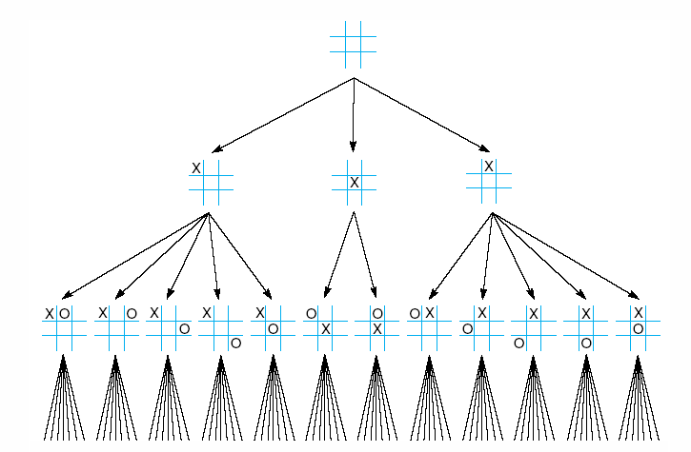
First three levels of the tic-tac-toe state space reduced by symmetry

Slide 23
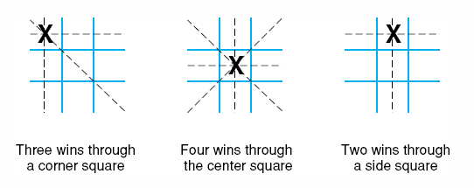
The “most wins” heuristic applied to the first children in tic-tac-toe.

Slide 24
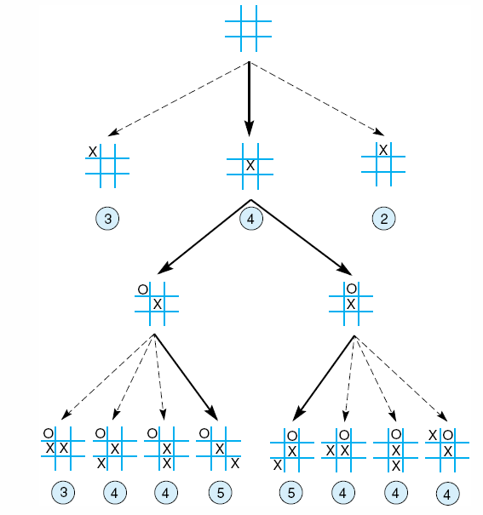
Heuristically reduced state space for tic-tac-toe.

Slide 25
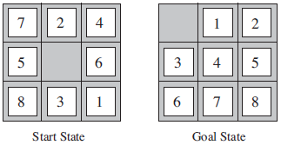
8–Puzzle: Heuristics?
h1: The number of misplaced tiles (squares with number).
h2: The sum of the distances of the tiles from their goal positions.

Slide 26
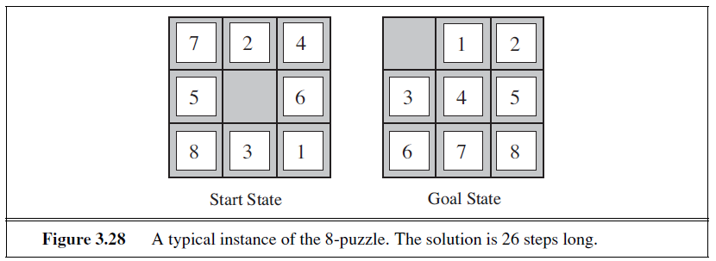
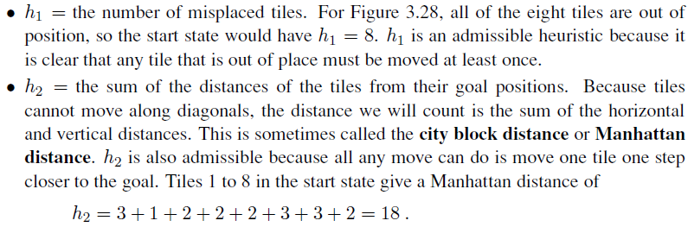

Slide 27
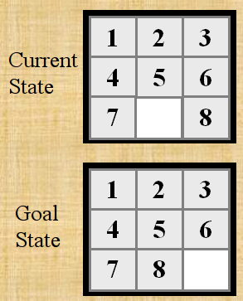

Slide 28
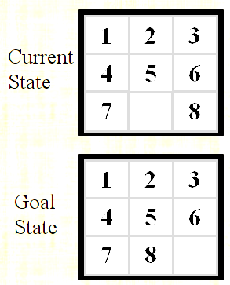
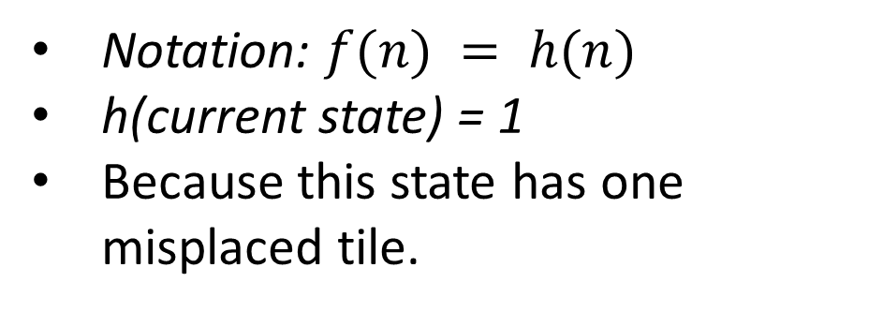
h1: The number of misplaced tiles (not including the blank)
Notation: $f(n) = h(n)$
h(current state) = 1
Because this state has one misplaced tile.
Only “8” is misplaced
So the heuristic function evaluates to 1.
The heuristic is telling us, that it thinks a solution might be available in just 1 more move.

Slide 29
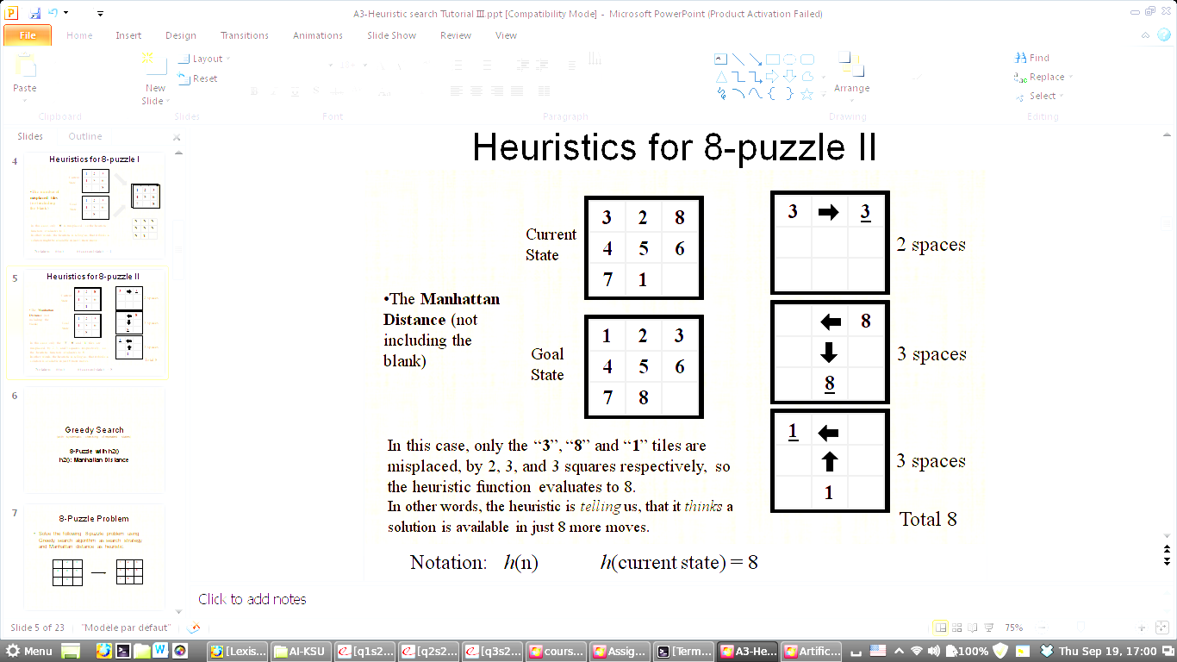
h2: The sum of the distances of tiles from goal positions
Notation: $f(n) = h(n)$, h(current state) = 8

Slide 30
Quiz

Slide 31
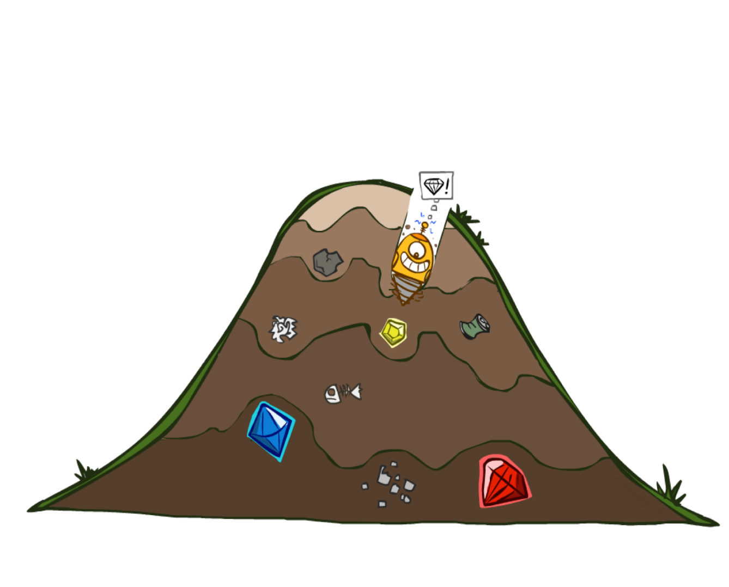
Greedy Best First Search
eval-fn: $f(n) = h(n)$

Slide 32
What is greedy best first search?
Greedy best-first search is a heuristic search algorithm used in artificial intelligence to find the shortest path between two nodes in a graph or tree. It is a variation of best-first search that uses a heuristic function to determine which node to expand next.

Slide 33
How Greedy search works?
In greedy best-first search, at each step, the algorithm selects the node that appears to be closest to the goal based on the heuristic function. The heuristic function estimates the distance between the current node and the goal, and the algorithm chooses the node with the lowest estimated distance as the next node to explore.

Slide 34
Greedy (Best-First) Search
Idea: Expand node with the smallest estimated cost to reach the goal.
Use heuristic function f(n) = h(n)
Best-first search tries to expand the node that is closest to the goal, on the grounds that this is likely to lead to a solution quickly.
Choose path with low heuristic value

Slide 35
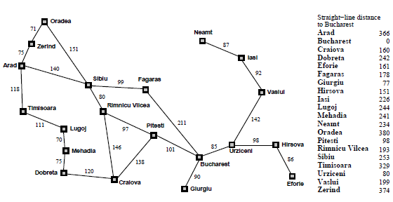

Slide 36
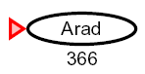
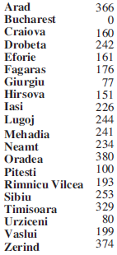
Greedy Search
Expand the node that seems closest…
What can go wrong?

Slide 37
Greedy Search
Expand the node that seems closest…(order frontier by h)
What can possibly go wrong?
Distance [Sibiu-Fagaras-Bucharest] =
99+211 = 310
Distance[Sibiu-Rimnicu Vilcea-Pitesti-Bucharest] = 80+97+101 = 278
h= 253
h=176
h=193
1000000
h=100
h=0

Slide 38
Greedy Search
b
…
Strategy: expand a node that you think is closest to a goal state
Heuristic: estimate of distance to nearest goal for each state
A common case:
Best-first takes you straight to the (wrong) goal
Worst-case: like a badly-guided DFS
b
…
Notes:
For any search problem, you know the goal. Now, you have an idea of how far away you are from the goal.

Slide 39
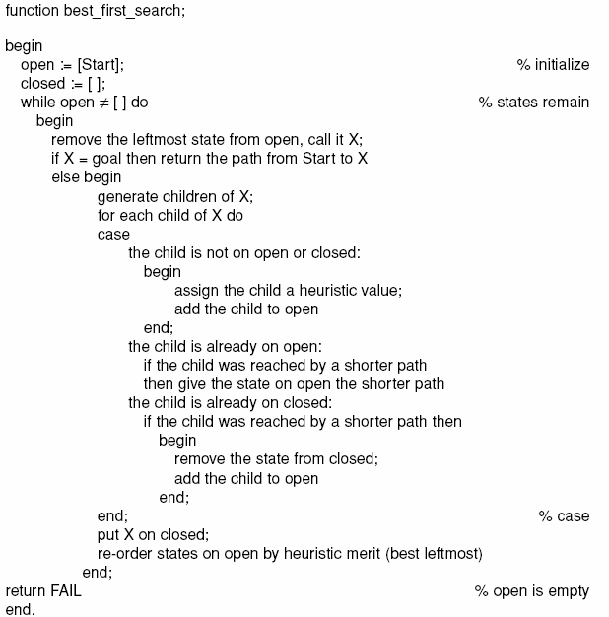

Slide 40
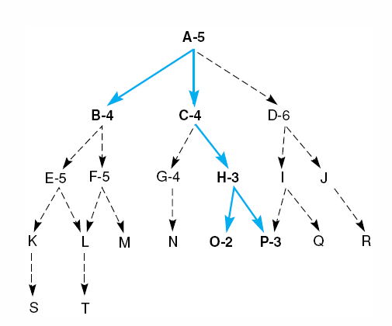
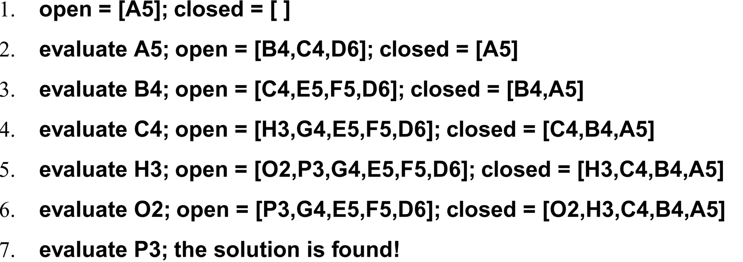
Best First Search
Goal

Slide 41
Greedy Search
State | Heuristic: h(n)
A | 366
B | 374
C | 329
D | 244
E | 253
F | 178
G | 193
H | 98
I | 0
Start
A
75
118
140
B
C
111
E
D
80
99
G
F
97
H
211
101
I
Goal
f(n) = h (n) = straight-line distance heuristic

Slide 42
Greedy Search: Tree Search
State | Heuristic: h(n)
A | 366
B | 374
C | 329
D | 244
E | 253
F | 178
G | 193
H | 98
I | 0
Start
A

Slide 43
Greedy Search: Tree Search
State | Heuristic: h(n)
A | 366
B | 374
C | 329
D | 244
E | 253
F | 178
G | 193
H | 98
I | 0
Start
A
75
118
[329]
140
[374]
B
C
[253]
E

Slide 44
Greedy Search: Tree Search
State | Heuristic: h(n)
A | 366
B | 374
C | 329
D | 244
E | 253
F | 178
G | 193
H | 98
I | 0
Start
A
75
118
[329]
140
[374]
B
C
[253]
E
80
99
[193]
[178]
G
F
[366]
A

Slide 45
Greedy Search: Tree Search
State | Heuristic: h(n)
A | 366
B | 374
C | 329
D | 244
E | 253
F | 178
G | 193
H | 98
I | 0
Start
A
75
118
[329]
140
[374]
B
C
[253]
E
80
99
[193]
[178]
G
F
[366]
A
211
[253]
I
[0]
E
Goal

Slide 46
Greedy Search: Tree Search
State | Heuristic: h(n)
A | 366
B | 374
C | 329
D | 244
E | 253
F | 178
G | 193
H | 98
I | 0
Start
A
75
118
[329]
140
[374]
B
C
[253]
E
80
99
[193]
[178]
G
F
[366]
A
211
[253]
I
[0]
E
Path cost(A-E-F-I) = 253 + 178 + 0 = 431
dist(A-E-F-I) = 140 + 99 + 211 = 450
Goal

Slide 47
Greedy Search: Optimal?
State | Heuristic: h(n)
A | 366
B | 374
C | 329
D | 244
E | 253
F | 178
G | 193
H | 98
I | 0
Start
A
75
118
140
B
C
111
E
D
80
99
G
F
97
H
211
101
I
Goal
f(n) = h (n) = straight-line distance heuristic
dist(A-E-G-H-I) =140+80+97+101=418
Not optimal!

Slide 48
Greedy Search: Complete ?
State | Heuristic: h(n)
A | 366
B | 374
** C | 250
D | 244
E | 253
F | 178
G | 193
H | 98
I | 0
Start
A
75
118
140
B
C
111
E
D
80
99
G
F
97
H
211
101
I
Goal
f(n) = h (n) = straight-line distance heuristic

Slide 49
Greedy Search: Tree Search
Start
A

Slide 50
Greedy Search: Tree Search
Start
A
75
118
[250]
140
[374]
B
C
[253]
E

Slide 51
Greedy Search: Tree Search
Start
A
75
118
[250]
140
[374]
B
C
[253]
E
111
[244]
D

Slide 52
Greedy Search: Tree Search
Start
A
75
118
[250]
140
[374]
B
C
[253]
E
111
[244]
D
Infinite Branch !
[250]
C

Slide 53
Greedy Search: Tree Search
Start
A
75
118
[250]
140
[374]
B
C
[253]
E
111
[244]
D
Infinite Branch !
[250]
C
[244]
D

Slide 54
Greedy Search: Tree Search
Start
A
75
118
[250]
140
[374]
B
C
[253]
E
111
[244]
D
Infinite Branch !
[250]
C
Even Incomplete in finite state space much like depth first search
(Complete in finite space with repeated-state checking)
[244]
D

Slide 55
Greedy Search: Time and Space Complexity ?
Start
Greedy search is not optimal.
Greedy search is incomplete
In the worst case, the Time and Space Complexity of Greedy Search are both O(b^{m})
Where b is the branching factor and m the maximum path length
A
75
118
140
B
C
111
E
D
80
99
G
F
97
H
211
101
I
Goal

Slide 56
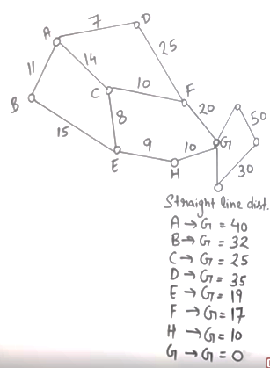
 | Frontier (Greedy) | Expand | Explored
1 | (A,40) | A | Empty
2 | (A-B,32)(A-C,25)(A-D,35) | C | A
3 | (A-B,32)(A-D,35) (A-C-E,19)(A-C-F,17) | F | A,C
4 | (A-B,32)(A-D,35) (A-C-E,19)(A-C-F-G,0) | G | A,C,F
5 | (A-C-F-G,0) Goal Found

Slide 57
 | Frontier (Greedy) | Expand | Explored
1 | (A,40) | A | Empty
2 | (A-C,25) (A-B,32)(A-D,35) | C | A
3 | (A-B,32)(A-D,35)(A-C-F,17)(A-C-E,19) | F | A,C
4 | (A-B,32)(A-D,35)(A-C-F-G,0)(A-C-E,19) | G | A,C,F
5 | (A-C-F-G) Goal Found |  | A,C,F,G
 | Frontier (UCS) | Expand | Explored
1 | (A,0) | A
2 | (A-B,11)(A-C,14)(A-D,7) | D | A
3 | (A-B,11)(A-C,14)(A-D-F,32) | B | A,D
4 | (A-B-E,26)(A-C,14)(A-D-F,32) | C | A,D,B
5 | (A-B-E,26)(A-C-F,24)(A-C-E,22)(A-D-F,32) | E | A,D,B,C
6 | (A-B-E,26)(A-C-F,24)(A-C-E-H,31)(A-D-F,32) | F | A,D,B,C,E
7 | (A-B-E,26)(A-C-F-G,44)(A-C-E-H,31)(A-D-F,32) | E | A,D,B,C,E,F
8 | (A-B-E,26)(A-C-F-G,44)(A-C-E-H,31)(A-D-F,32) | F
9 | (A-B-E,26)(A-C-F-G,44)(A-C-E-H,31)(A-D-F,32) | H
10 | A-C-E-H-G,41 Goal Found

Slide 58
Heuristics
Problem:
A heuristic is only an informed guess of the next step to be taken in solving a problem.
It is often based on experience or intuition.
Heuristics use limited information, such as knowledge of the present situation or descriptions of states currently on the open list.
They are not always able to predict the exact behavior of the state space farther along in the search.
A heuristic can lead a search algorithm to a suboptimal solution or fail to find any solution at all. This is an inherent limitation of heuristic search.

